Slide 1
GitHub

Slide 2
There is a lot of learning material and YouTube videos online.
However, almost all of the introductory material is either very long winded, too technical, or too broad. I’ve tried to make it so that everything you will need to know is squashed in one place: here. But I would encourage to read around.

Slide 3
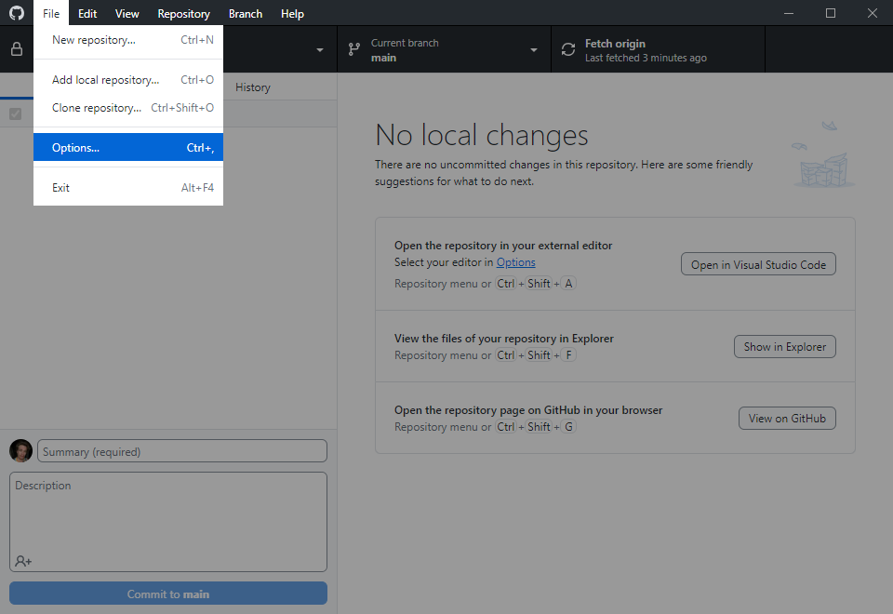
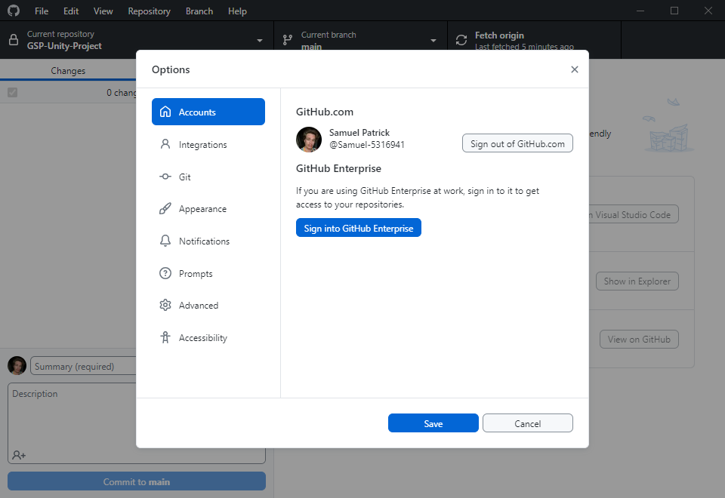
SIGN IN
Go to File > Options
Ensure you are signed in
Review software specification versions on Discord (for all software)

Slide 4
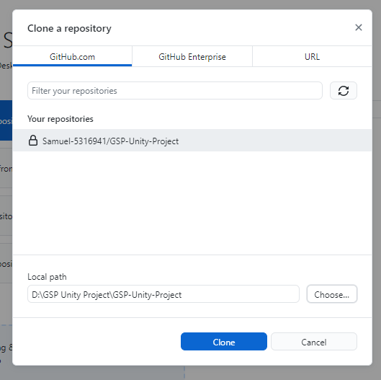
CLONE THE REPOSITORY
This section is duplicated from the on-boarding; skip if you’ve already done it.
Go to File > Clone Repository … and then you should see our repo, “GSP-Unity-Project”. Select that one.
You should clone the repository somewhere out of the scope of any other version control or cloud storage (OneDrive, Google Drive, Dropbox etc). If possible, use the C: drive or D: drive or similar. Directly on the drive you can create a folder called “Git Repositories”.
You should have something like this (and if so, you can Clone)

Slide 5
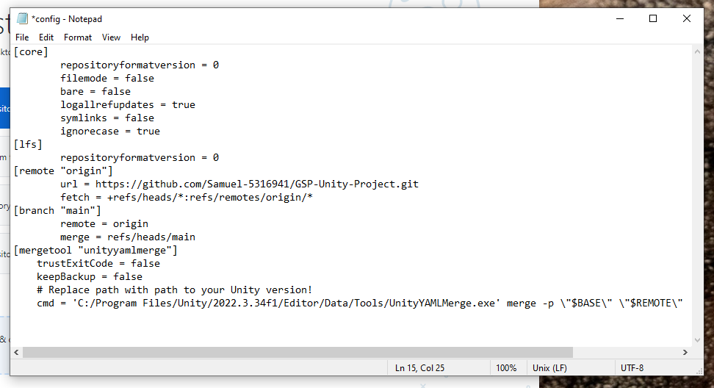
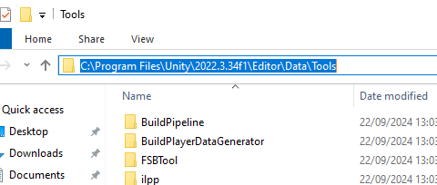
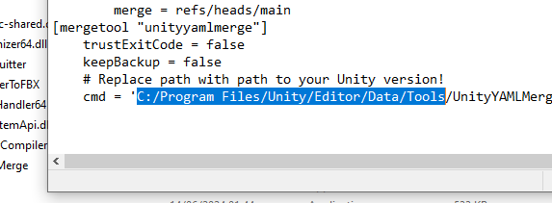
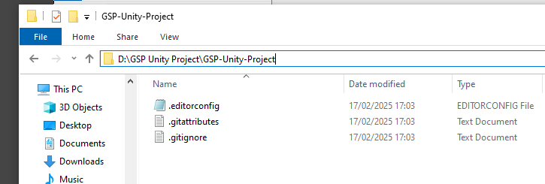
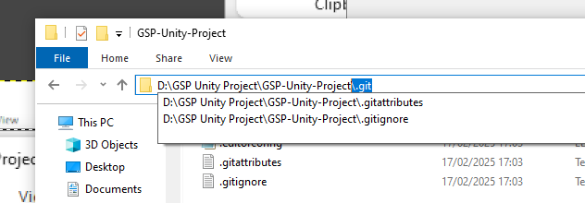
CONFIGURE UNITY YAML MERGE
This must be done every time you clone the GSP-Unity-Project repository (for instance, if you clone in the Labs, you should configure it even if you did it on your local machine).
Navigate to the repo you just cloned. Go to the folder file path, and type the highlighted below onto the end:
This should open up a hidden folder. Open the file “config” in a text editor (right click, Open with…, scroll to Notepad).
Copy this text and paste it in the “config” file. You should have something like this:
Navigate to your Unity installation. You’re looking for the UnityYAMLMerge.exe. It should be somewhere around here, in the Tools folder:
Copy the file path (you’ll have to Ctrl+C). Go to the “config” file in the text editor. Highlight the below path exactly and paste over it exactly with your own path.
[mergetool "unityyamlmerge"]
trustExitCode = false
keepBackup = false
# Replace path with path to your Unity version!
cmd = 'C:/Program Files/Unity/Editor/Data/Tools/UnityYAMLMerge.exe' merge -p \"$BASE\" \"$REMOTE\" \"$LOCAL\" \"$MERGED\"

Slide 6
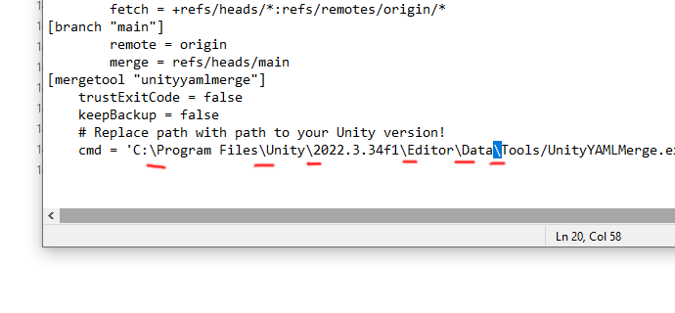
CONFIGURE UNITY YAML MERGE (cont)
You must replace the back-slashes in the text you pasted (from “C:” to “Tools”) with forward-slashes again. Ignore the back-slashes later in this line after the “-p”, they are supposed to be this way. Save the file.
[mergetool "unityyamlmerge"]
trustExitCode = false
keepBackup = false
# Replace path with path to your Unity version!
cmd = 'C:/Program Files/Unity/Editor/Data/Tools/UnityYAMLMerge.exe' merge -p \"$BASE\" \"$REMOTE\" \"$LOCAL\" \"$MERGED\"

Slide 7
REMOVING THE REPO(S) (LABS ONLY)
When you are finished working in the Labs, make sure your changes are committed and pushed.
If you unsure you are pushed, you can check on the GitHub website and look at the repo if you are unsure before you delete the repo from the Lab PC.
Go to Repository > Remove… in GitHub Desktop, then select our repo(s), and remove them, and please tick the box that says “Send to Recycle Bin”).
Any unpushed changes, even committed ones, will be gone forever when you delete a local repository.

Slide 8
Pushing Changes

Slide 9
Hopefully by now you understand the principles that a repository exists remotely and can be cloned on a local machine, and that from there you can make changes and update the remote repository.
Remote Repository
Clone repository
Local Repository
Push changes

Slide 10
However, there are more steps involved in pushing changes to a remote repository.
Local
?
?
Push
Remote

Slide 11
Changes that are made locally have to be committed. Commits are supposed to represent some kind of “finished step” in your work. A commit therefore represents a snapshot in history of your file(s). You can make as few or as many commits as you need before you push those changes.
When you push, your commit history is also pushed, so in the remote repository you have made available your latest changes as well as a record of all the other commits you made.
Remote Repository
Remote Repository
Commit changes
Working Directory
Local Repository
Push your commits

Slide 12


Commits you make are local. They won’t be available on the remote repository unless you push them.
You do not have to push commits until you are ready and tested. That might take several days and several computer restarts. That’s okay. GitHub Desktop will store your commit history locally for as long as it takes until you’re ready to push your changes.
Remote Repository
Remote Repository
commit
commit
commit
commit
a
b
c
d
e
b
c
d
e
push
Local Repository
Local Repository
Local Repository
Local Repository
Local Repository
If at this point someone else clones the repo, they won’t get your commits.
Local Repository
clone
Oldest commit history
Latest commit history

Slide 13
What is in a commit? Why commit things in steps? Why not just commit everything all at once and push at the end of the working day?
Commit ID
History/changes
Commit summary
Timestamp
Author
The only thing you’ll have to specify is a summary. There is a lot of dogma about how to write the summary. Most developers will stick to something that is simple, explanatory, and present tense.
Summary example: Update table prop
Guilty of thing_final_final_draftv25?
What your workflow tells you is that you would benefit from Git commits.
If you commit all in one go, all those steps you took to get there are squashed into one commit. What if you want to go back to
thing_final_final_draftv23?
If you make sensible, regular commits, you can roll back to an earlier working version. Rolling back will revert your working directory to exactly how it was in the last commit.
If you mess something up, you can roll back one, some or even all of your commits since your last push. Imagine one little thing went terribly wrong and you had to undo all your work since the last push. If you have multiple commits, then you lose minimal work.

Slide 14
Now you know about commits, there is one last step to know.
Local
?
Commit
Push
Remote

Slide 15
A
B
C
Remote Repository
Let’s say after you cloned the repo, you made some changes:
you deleted file A
you edited file B
you created file C
GitHub Desktop will record your changes in the staging area.
Let’s rewind to when you finished your work and everything was in the staging area.
One answer is to work on one file/issue per commit, but this does not always reflect the reality of editing. Instead, you can unstage anything you don’t want to commit for now. Then, you can commit one “chunk” at a time.
At this stage, if you make a commit, GitHub will take everything in the staging area and package it in one commit.
Remote Repository
But what about accurate naming? What if you deleted an old file, fixed a bug, and created a new prop? Let’s say you made 100 edits over those three files and committed them at once. That’s messy to unpick if something is wrong with only one file but you want to keep the changes you made to the other two.
A
B
GitHub Desktop
automatically staging changes
GitHub Desktop
checks what files are staged when you create a commit
Clone repo
Making changes
Latest pushed commit(s)
Commit changes
Working
Directory
Staging
Area
Local Repository Commits
Remote Repository Commit History
Push your commits
A
File A deleted!
A
A
A
B
B
C
B
File B edited!
C
File C created!
Staging area
automatically clears
Commit(s)
ready to push
Previous pushed commit(s)

Slide 16
A
B
C
Remote Repository
Let’s say after you cloned the repo, you made some changes:
you deleted file A
you edited file B
you created file C
GitHub Desktop will record your changes in the staging area.
Let’s rewind to when you finished your work and everything was in the staging area.
One answer is to work on one file/issue per commit, but this does not always reflect the reality of editing. Instead, you can unstage anything you don’t want to commit for now. Then, you can commit one “chunk” at a time.
Replay this slide a few times, watch the icons, read the text
Remote Repository
GitHub Desktop
automatically staging changes
GitHub Desktop
checks what files are staged when you create a commit
Clone repo
Making changes
A
You make
a commit (notice only file B changed, and A is gone because it was deleted) Don’t forget, each commit’s changes
are compared to the previous commit, or if there isn’t a local commit currently, then the latest commit on the remote repo
B
Files committed are cleared
from staging area
(because there is now no
difference in local file
and latest local commit) if they are edited again,
they’ll get automatically staged again
You make
a commit (notice only file A changed) Don’t forget, this commit is
comparing changes against
the latest commit in the repo!
Latest pushed commit(s)
You make
a commit (notice only file C changed)
You choose what changes are staged
Commit changes
Working Directory
Staging
Area
Local Repository Commits
Remote Repository Commit History
Push your commits
File A deleted!
A
B
B
A
File B edited!
File B edited!
B
C
B
File C created!
File C created!
C
Previous pushed commit(s)

Slide 17
Let’s say after you cloned the repo, you made some changes:
you deleted file A
you edited file B
you created file C
GitHub Desktop will record your changes in the staging area.
Now, when you push, the repo’s latest commit is stuffed into the history, your previous commits are stacked on top, and then your latest commit is now the repo’s latest commit.
Then, your local repo and the remote repo are matching again, GitHub Desktop will have an empty staging area, and your local commits will be now part of the remote commit history, as are everyone else’s.
Remote Repository
A
B
B
C
B
C
Latest pushed commit(s)
Working Directory
Staging
Area
Local Repository Commits
Remote Repository Commit History
A
A
B
B
A
B
B
C
B
B
B
C
Previous pushed commit(s)

Slide 18
You’ve hopped about across a few different files …
edit
edits
Commit: Update table prop
edit
5.05pm
2pm
edit
edits
Commit: Fix bugs in plant prop
edit
5.07pm
edit
edits
edit
Commit: Create window prop
5.08pm
edit
4pm
edit
Staging only some files and committing them before staging files from an unrelated task and committing those, straightens out your edit history into neat commits. If you don’t fold your laundry and put it in the correct drawers, you have to root out your entire closet for a single thing when you really need it fast, and you’ll mess up your room in the process.
edit

Slide 19
Probably too often
Goldilocks
Probably too little
Commit: Edit texture for table prop
Commit: Update table prop
Commit: Everything I did today
(Let’s say you made 2 edits)
(Let’s say you made 12 edits)
(Let’s say you made 329 edits)
Commit: Edit UV for table prop
Commit: Fix bug in plant prop
(You made 1 edit)
(Let’s say you made 4 edits)
Commit: Fix topology for table prop
Commit: Create window prop
(2 edits)
(Let’s say you made 19 edits)
Commit: Edit texture for table prop
(1 edit)
Commit: Edit texture for table prop
(1 edit)
So how often should you make a commit?
Ultimately it is somewhat up to you, but your commit history needs to be understandable to yourself and others all the way back to the beginning. Committing every tiny little edit you make is too granular to be meaningful, and committing everything all at once can make extremely hard to find the origin of bugs or problems.
Commit: Fix UV for table prop
(1 edit)

Slide 20
This looks complicated, but once you’ve done it a few times, it’s pretty simple. GitHub Desktop encapsulates nearly all of this functionality for you, and it’s a case of pressing a few buttons. For most of the time, this is all any of us will need to do with Git and GitHub.

Slide 21
Now you know about the staging area.
You hopefully also understand that these steps are more of a continual cycle until you’re ready to push your work: local edits, staging, committing.
Local
Stage
Commit
Push
Remote

Slide 22
Fetching Changes

Slide 23
This might have been enough to get started, were you working alone. But we need to consider that many people will be concurrently pushing changes to the remote repository, and you’ll need to adopt them.
Let’s take an example. Alice and Bob both clone a remote repo locally. They start out with the same version/commit as the remote repo.
Remote Repository
Push commits
Alice goes to sleep, but Bob pulls an all-nighter: he edits, makes commits, and pushes to the repo.
Clone repository
Clone repository
Alice’s Local Repository
Alice has not done anything yet, but already her local repo is out of sync with the remote repo. Bob is several commits ahead.
Alice’s Local Repository
Bob’s Local Repository
Alice has several options:
Work on her repo anyway and try push her changes
She fetches changes from the remote repo, reviews them, and merges them into her local repo
She fetches and reviews, but before merging, commits, merges and then pushes
Blindly pull changes into her repo
Other more advanced approaches like rebasing

Slide 24
1. Work on her repo anyway and push her changes
Remote Repository
If Alice is so inclined, she can edit her local repo however she likes, and then try and push the changes.
A
B
C
Push rejected
Alice’s Local Repository
If Alice plans to work on File A, then when she pushes, Git will reject her push. This is different than a conflict: conflicts are sometimes painful but very allowed. This situation is not, so Git rejects it. Git recognises that the remote repo has newer commits from Bob that Alice lacks.
Bob’s Local Repository
Alice’s Local Repository
Bob’s Local Repository
What happens if Alice now decides to edit File C?
A
A
A
A
B
What about if Bob now edits File A?
B
C
C
C
If you look at all three repos, there are conflicting versions, and things are quickly getting messy. Not one file that Alice and Bob share are on the same version. When Alice now tries to merge her repo to get out of her pickle, they will run into merge conflicts.

Slide 25
It is worth mentioning that Alice was not doomed: this can and sometimes does happen, and there are ways out of it. It is good to avoid a situation like that if it is not necessary, however.
So, what could have been done to prevent this? Let’s rewind: Bob has gone to sleep after his all-nighter.
Option 2: Alice fetches changes from the remote repo, reviews them, and merges them into her local repo
Remote Repository
A
B
C
Fetch origin
Make changes
Merge
Alice’s Local Repository
When Alice gets to work, before she does anything, she fetches the latest commit. She reviews the changes and sees that there are no conflicts.
Alice’s Local Repository
Bob’s Local Repository
Alice then merges the latest commit with her own working directory. Alice’s File B and File C are different than the remote repo, however Git recognises that her current commit’s ID matches a commit historic to the latest one pushed by Bob. This is called a fast-forward merge (and GitHub Desktop manages this automatically): no new commits are being made here, Alice is simply catching up to speed. She can now make changes safely.
A
A
A
A
A
A
B
B
B
C
C
C
C
Alice could now push her changes if she wanted, and Bob can perform a fetch and fast-forward merge when he gets to work. Alice and Bob can work like this, back and forth, in safe knowledge that they might never have to merge a conflict between them.

Slide 26
However, at times where significant collaboration or concurrent work is required, this may be too idealistic an approach. Sometimes work patterns require that local repositories simply must diverge from each other.
Option 3: Whilst Alice was making edits, commits have been made to the remote repo by Bob. She fetches changes from the remote repo, reviews them, and merges them into her local repo
Remote Repository
A
A
B
B
Push commits
C
C
Push changes
Clone repository
Clone repository
Fetch origin
Makes changes
Makes changes
Merge
Alice’s Local Repository
There is now a situation where Alice has made commits and hasn’t yet pushed, but her repo is missing commits that Bob has pushed while she was working. If she tries to push now, it will be rejected, because she’s behind.
Bob’s Local Repository
So, Alice must fetch the latest changes from the remote repo. She can review Bob’s changes and see in advance if they will conflict her own. In this case, Alice and Bob communicated their intent in advance and they agreed Alice will work on File A while Bob will work on Files B and C. On review, Alice sees Bob has kept his word, and she merges his changes into her local repo without experiencing any conflicts. This will create a merge commit in the history, which she can now push to the remote repo. So far there are no issues. If her push is now successful, Bob can now fetch her changes and they can work in tandem like this.
A
A
A
B
B
B
B
C
C
C
C

Slide 27
However, at times where significant collaboration or concurrent work is required, this may be too idealistic an approach. Sometimes work patterns require that local repositories simply must diverge from each other.
Option 3: Whilst Alice was making edits, commits have been made to the remote repo by Bob. She fetches changes from the remote repo, reviews them, and merges them into her local repo
Remote Repository
A
A
B
B
Pushed commits
C
C
C
Push commit
Fetch origin
Fetch origin
Makes changes
Merge
Merge
I mentioned option 4 earlier: blindly pull. Pull will fetch the changes and merge them, in one step, without a chance for review. This is helpful if you are confident there aren’t complicated merge conflicts.
Things might still go wrong, however. Let’s take a contrived example and rewind a little: Bob has just pushed his changes while Alice was working on her File A.
Alice’s Local Repository
Alice did all the right things : she fetched, reviewed Bob’s changes, merged them with her own, and now she will try to push, like in the previous example.
Bob’s Local Repository
This worked fine before, but in this scenario, her push would still be rejected. This is because while Alice was fetching, reviewing and merging, Bob snuck in another push while she was occupied.
A
A
A
A
B
B
B
Alice is now behind again. She must fetch again and merge again and ideally ask Bob to hold off for a minute.
B
C
C
C
C
C
C
Now Bob fetches and merges Alice’s changes. Alice and the remote repo now are aligned and have the same files and commit history.

Slide 28
Let’s look at the same example but from a different angle. This time instead of focusing on file changes we will watch the commit history at each step.
Alice’s Local Repository
Remote Repository
Bob’s Local Repository
When Alice and Bob join the repo, there are already 3 historic commits.
They clone the repo.
1
1
1
Alice’s previous
commit is not the
remote’s latest commit
Bob’s previous
commit is the remote’s
latest commit
Bob makes some changes and commits them.
2
2
2
Alice makes some changes and commits them.
Alice’s previous
commit is not the
remote’s latest commit
Bob’s previous
commit is the remote’s
latest commit
Bob finished testing his feature and pushes the commit he made.
(latest)
3
(latest)
3
(latest)
3
Alice’s previous
commit is* the remote’s
latest commit
Alice tries to push her feature, but she is missing commits. Her push is rejected. Really, commits have hashed IDs, but you can imagine that Alice’s commit should be numbered 5, but she is missing Bob’s commit 4.
(latest)
4
(latest)
4
(latest)
4
(latest)
5
(latest)
5
(latest)
5
Alice fetches and creates a merge commit.
Bob commits and pushes before Alice can push.
(latest)
6
(latest)
6
(latest)
6
Alice is rejected again.
Alice fetches and makes a merge commit, and this time succeeds to push.
Bob fetches and makes a merge commit. He has nothing to push: he is just adopting Alice’s changes.

Slide 29
The last and final option 5 is rebasing. On the surface, you get the same result as a merge. Under the hood, however, the commit history is organised in a different way. It circumvents the need for merge commits which hold little meaningful information and can propagate in their thousands in big projects.
We will use the same contrived example with Alice and Bob. If you look at their shared commit history, Alice and Bob had to go through five commits for Bob to finally get Alice’s changes.
Alice’s Local Repository
Remote Repository
Bob’s Local Repository
1
1
1
2
2
2
This scenario is appropriate for commits where there is not a large potential for conflict. If you have many conflicting files, you will have to merge them for as many commits you are rebasing. This can be very arduous indeed if there are significant conflicts. There are other more advanced considerations when rebasing but they are out of the scope of our needs.
Let’s go back: Bob has just committed his changes and Alice is behind the remote repo. Since in this scenario Alice decided that she will rebase her repo, we can do away with the attempted merge commits.
3
3
3
Alice now rebases her repo. Her latest commit is held aside.
4
4
4
4
(latest)
4
Any commit that Alice lacks is now tested, in order, against her own latest commit for merge conflicts. We know that Alice was fiddling with File A and Bob was fiddling with File B and C so we’ll presume there are none.
5
4
5
(latest)
5
(latest)
5
6
6
(latest)
6
(latest)
(latest)
6
There were no merge conflicts, so Alice’s commit can absorb, from behind, the changes from the commits ahead of hers. The hashed commit ID will now be rewritten, and she would be able to push her commit to the remote repo – or, she can continue committing until her feature is finished if it isn’t yet.

Slide 30
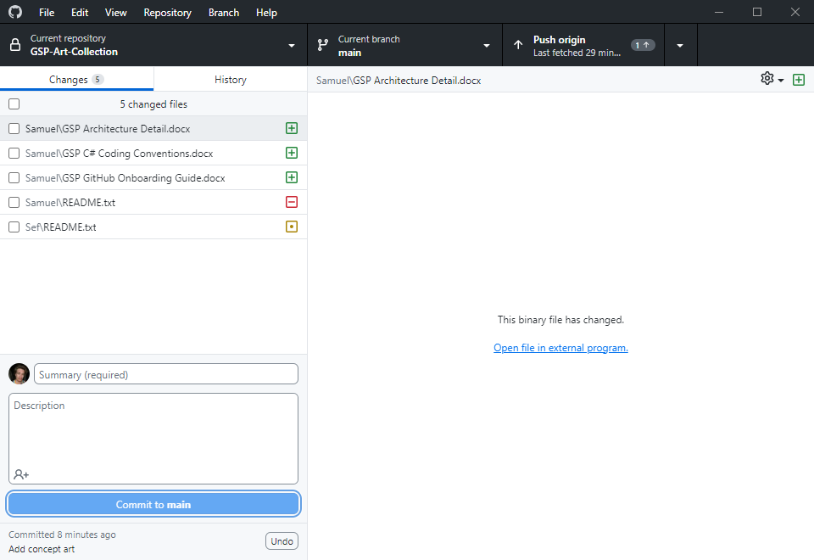
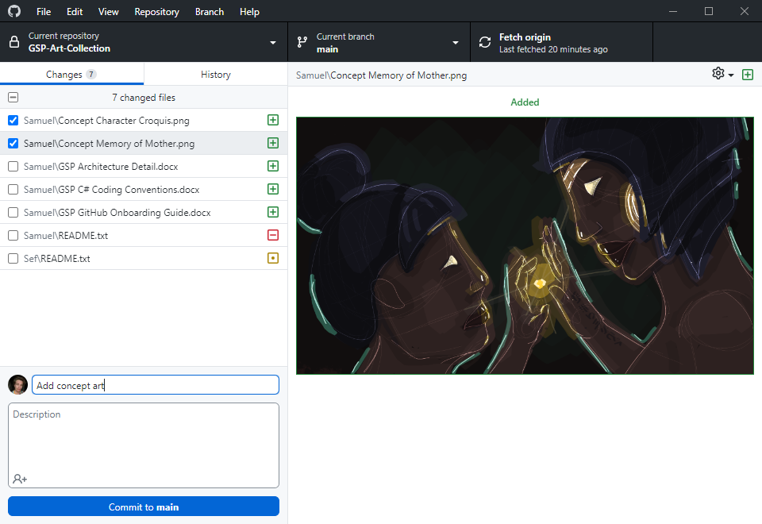
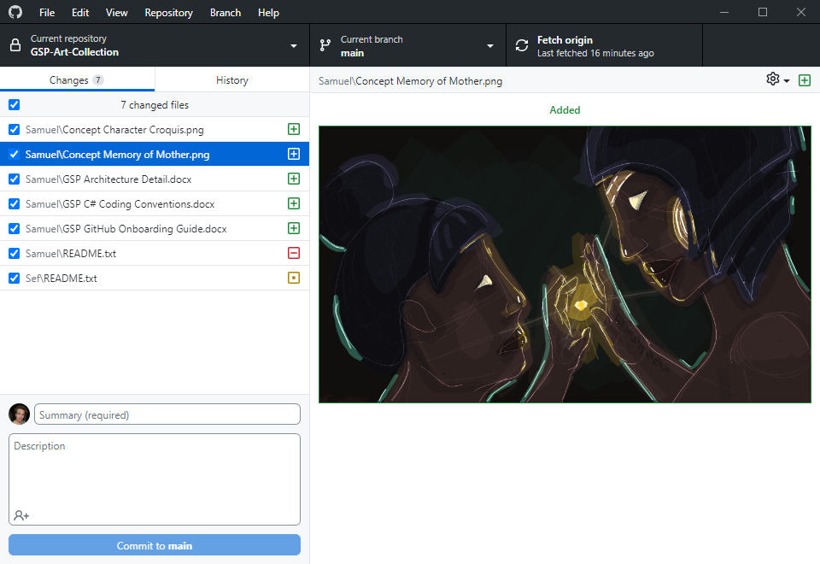
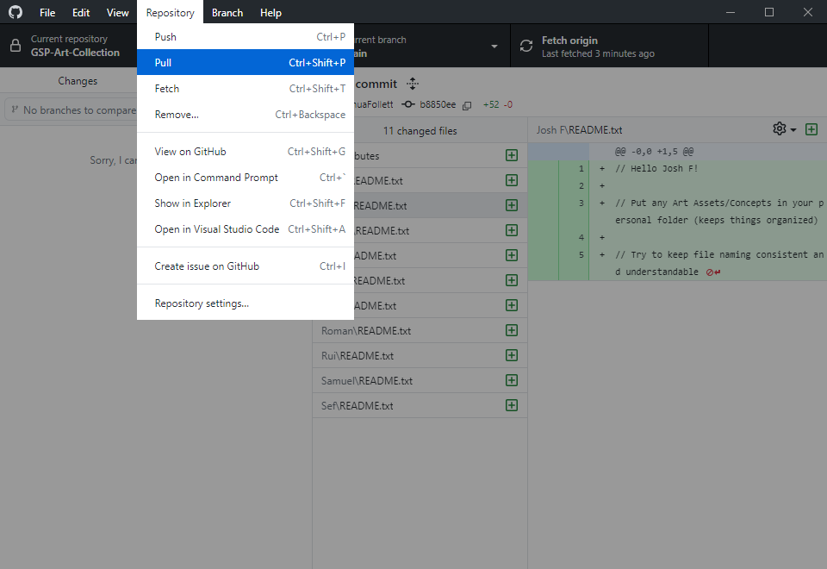
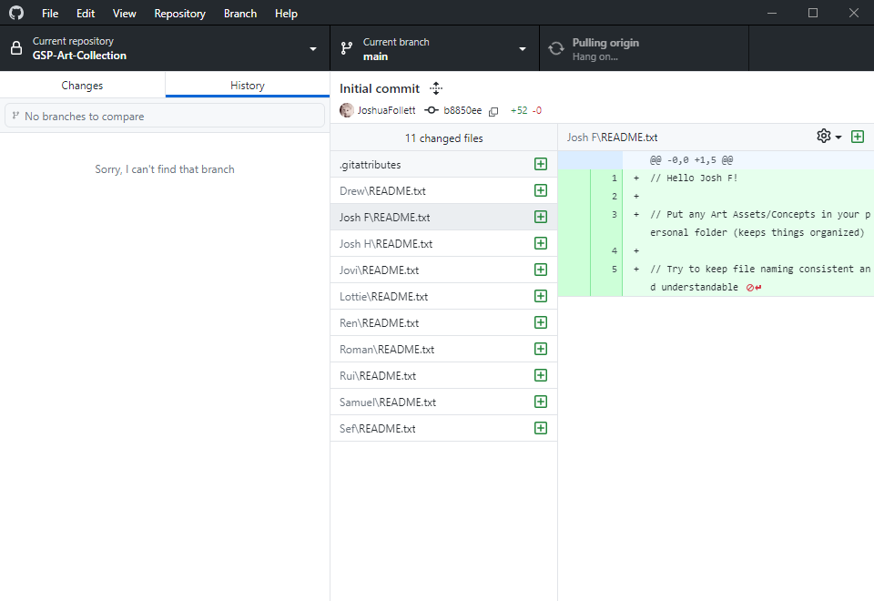
SESSION WORKFLOW
Before making any changes, make sure the correct repository is selected, and the correct branch, and then pull from the repository. This will fetch changes from the remote branch and fast-forward merge your local branch to the latest commit.
This is a network process and can take a while if there are many commits. See “Pulling origin, hang on…”
When you have made changes and you are ready to commit, you can go to the changes tab to see the staging area.
You can see that my local branch has now diverged from the latest commit (in this case, the remote branch’s latest commit). GitHub Desktop will highlight the nature of the changes: new, deleted, or edited.
Any changes you uncheck will be unstaged. Select only the files you want to commit. I have selected only the art files. It is crucial to commit sensibly; see slides 13, 18 and 19 for more guidance. Description and co-authors is not mandatory.
Now that I have committed, those changes are cleared from the staging area.

Slide 31
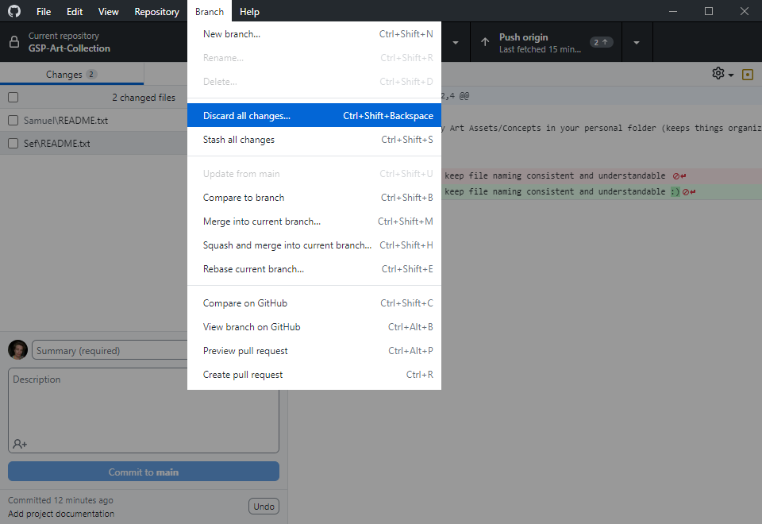
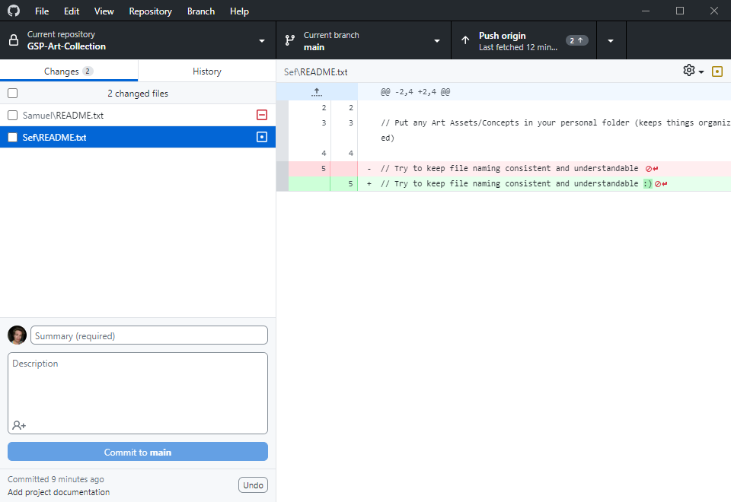
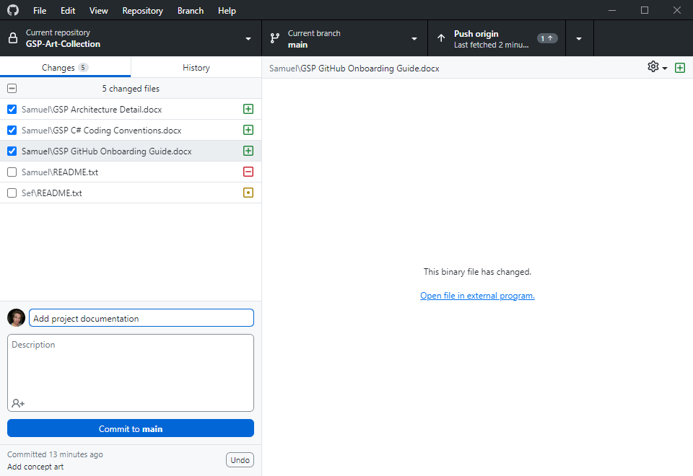
SESSION WORKFLOW (cont)
I will make another commit. In the staging area, the changes are compared to the latest commit which is now my unpushed “Add concept art” commit. See slides 15-17 if this doesn’t make sense.
Since these commits are not yet pushed, they are not yet available to others remotely.
Now I’ve committed everything I want to, I’m left with two files I didn’t mean to change.
I can discard these changes. This will discard any changes since the last commit, whether pushed or unpushed.
Let’s analyse this:
In the “Add project documentation” commit, these two files will be referenced “unchanged since last commit”.
So Git looks back to to the previous “Add concept art” commit and sees again “unchanged since last commit”.
Then tracks back again (Josh’s initial commit which I pulled) and sees for both files “file was created”. It is comparing my changes to this information. It will restore those files as they were then.

Slide 32
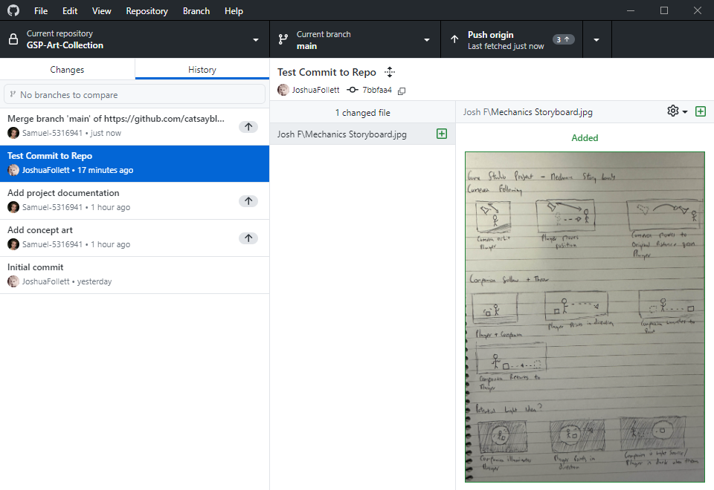
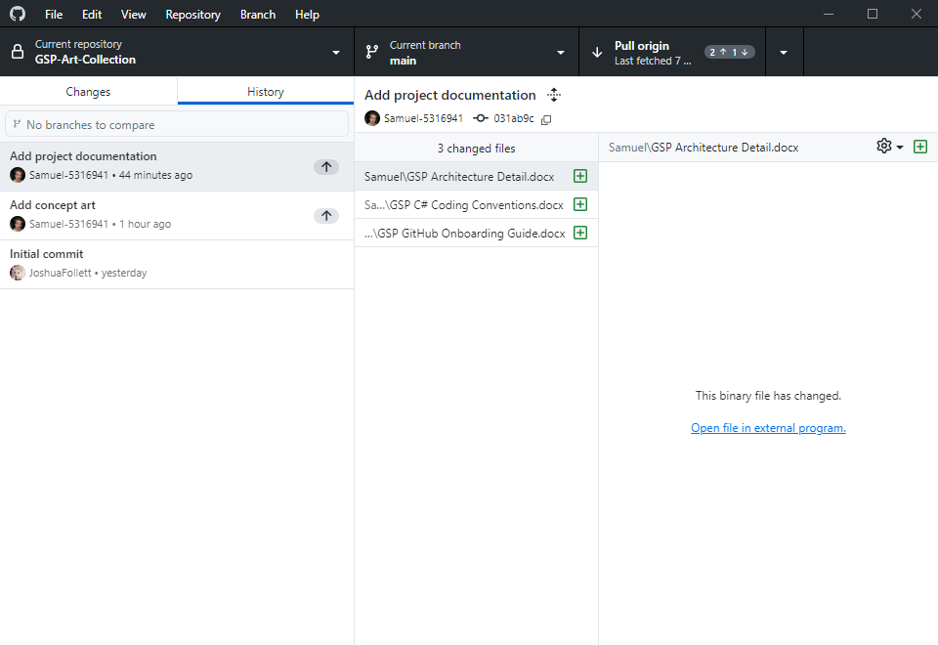
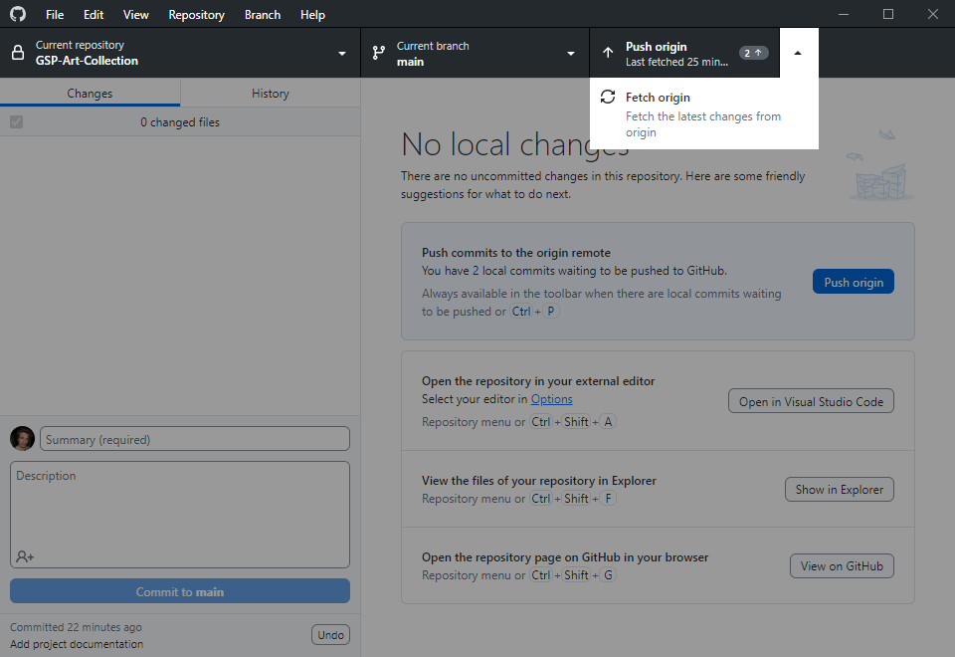
SESSION WORKFLOW (cont)
Now that you have no local (uncommitted) changes, and we are finished editing, we can push. Notice the little 2 next to push origin. That’s because there are two unpushed commits. If you look at the history tab, your unpushed commits will have a little arrow next to them to signal that they aren’t yet pushed.
Before push, we should fetch origin. There is a chance someone pushed changes since I last pulled.
Now I’ve fetched, notice how push origin has now changed to pull origin and a little 1 has also appeared. That’s because someone did indeed make a commit and I am behind.
There are ways to see the fetched changes and compare them to your commits. Regrettably, GitHub Desktop doesn’t provide that functionality. So in this scenario, you must blindly pull (which will merge them into your local branch) to get back on track.
Josh’s commit has been pulled into my local branch. This created a merge commit which merged Josh’s pushed commit and my unpushed commits together. Luckily, we didn’t touch the same files. If we did, we’d have to manage a merge conflict.

Slide 33
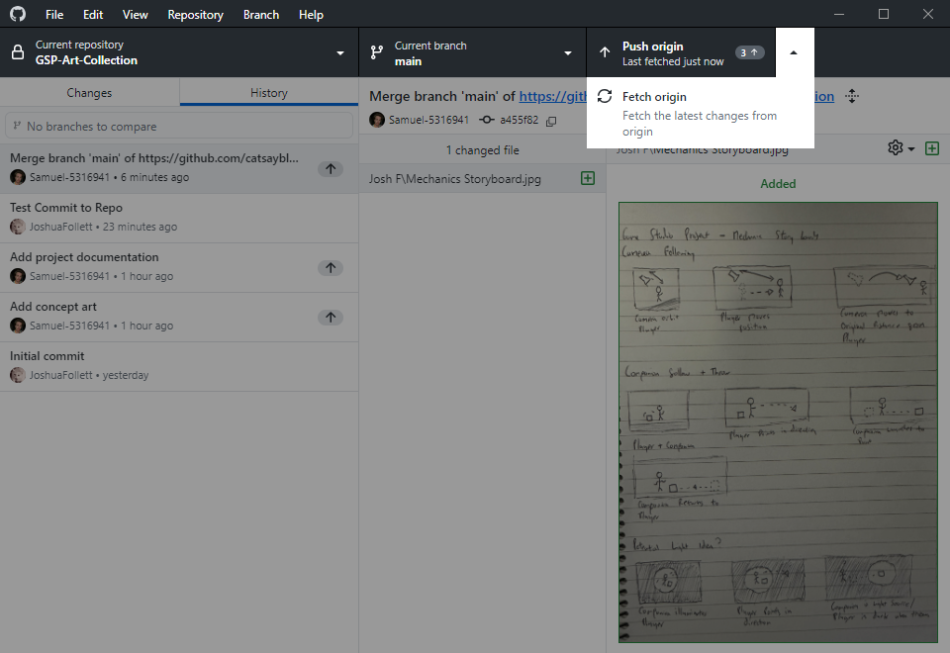
SESSION WORKFLOW (cont)
Now that the merge commit is dealt with, you should fetch again. We didn’t spend long on this merge commit but if there was a really big change by someone else we might have had a lot of conflicts to solve.
This is why if you are facing a conflict, it’s a good idea to call for backup, and ask people to stop piling on and pushing more commits while you work through it.
So I’ve fetched and there’re no changes to the repo since I last pulled. I can now push my changes. Notice it now says 3: I didn’t make a new commit, but Git automatically created a merge commit when I pulled. This only happens if Git cannot fast-forward (i.e., someone has pushed since you last made a commit).
My local branch is now harmonious with the remote branch.
Any changes you do not commit will never be pushed. Others will not be able to pull them from the remote branch.

Slide 34
SESSION WORKFLOW (Cheatsheet)
When to fetch or pull?
Whenever you get to work and open GitHub desktop, use these scenarios.
You can see it is simpler and easier to regularly push your changes, but it is inadvisable to push stuff that is largely incomplete or broken (your commits may be pulled by people who rely on them!)
Push when you can, and let people know if you’ll be working on something for a few days before you can push the changes.
I have no unpushed commits and no local changes
You can safely pull and your directory will be fast-forwarded to the latest commit
I have unpushed commits and no local changes
You should fetch, pull, merge conflicts if required, continue working and committing or push if you are ready (preferably push if your feature is relatively complete)
I have local changes
You should first finish your edits and commit them, or discard them if they were not deliberate, fetch, pull, merge conflicts if required, then continue working and committing or push if you are ready (preferably push if your feature is relatively complete)

Slide 35
Merge Conflicts

Slide 36
Merge conflicts sometimes inevitably arise. There is a lot of dogma about how they should never happen, and if they do, you are doing something wrong. I would say that does not reflect the reality of collaborative projects. In principle, they are very simple to understand.
Effort should be made to avoid them if possible, but work through it if that’s what is required.
Remote Repository
A
B
C
Alice and Bob have both edited File C. There are several options (probably option one or two are best):
Bob can push, and Alice can fetch, then manually review the conflict, and decide whose file to keep, then merge, handle the merge conflict how she planned, and then consult Bob about adopting his binned changes to her version of File C (or vice versa)
Bob can push, and Alice can revert or reset her unpushed commit(s) if the effort required to resolve the conflict is less than redoing the feature, or if both of you have accidentally overlapped and completed similar work (or vice versa)
Bob can push, Alice can rebase her commit and handle the merge conflicts from behind (or vice versa)
If Bob pushed, any push from Alice will be rejected, because it will make her behind, though Alice can force push (the nuclear option, a last resort) which will overwrite whatever commits Bob has made that conflict her changes (disabled on a lot of repositories for non-admins)
NB. If the merge conflict is overwhelming or taking up more time than you expected (many files), you can abort it and come back to it another time or get backup.
Alice’s Local Repository
Bob’s Local Repository
A
A
B
B
C
C

Slide 37
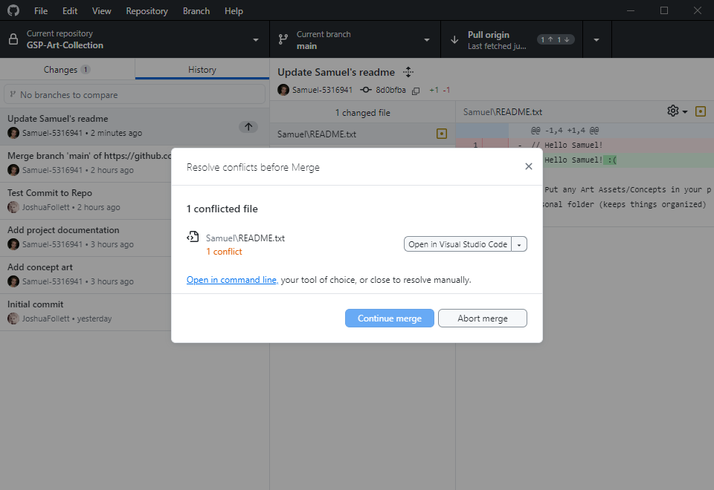
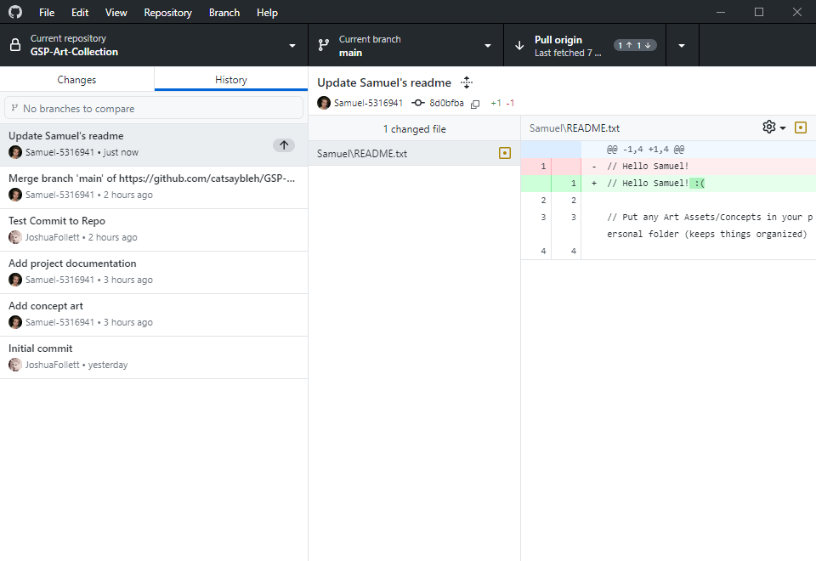
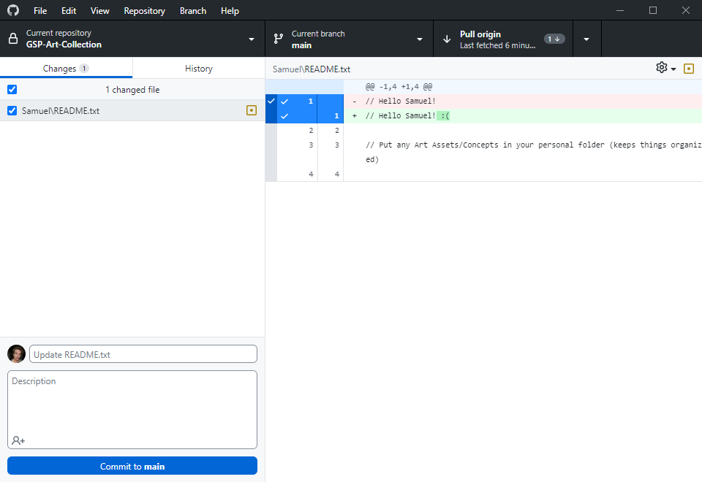
MERGE CONFLICTS
You can see I have edited a text file.
Now I will commit this change.
Now I have fetched before pushing. You can see I have one commit to push (my text file) and I am also one commit behind (Josh has made a commit). We need to pull the changes Josh made into my commit and create a merge commit before I can push.
We have run into a merge conflict. In my commit, there are files which were also edited in Josh’s commit.
If the merge conflict is too complex, you can abort it and call for backup.
Only when you have resolved all conflicts will it be possible to continue merge.
With text files, Git will manage a lot of the merge scenarios intelligently.
However, with art assets, this is reduced to a simple choice. Unity assets normally are incompatible for an intelligent or graceful merge. You will need to choose one or the other and we will treat this text file the same way.

Slide 38
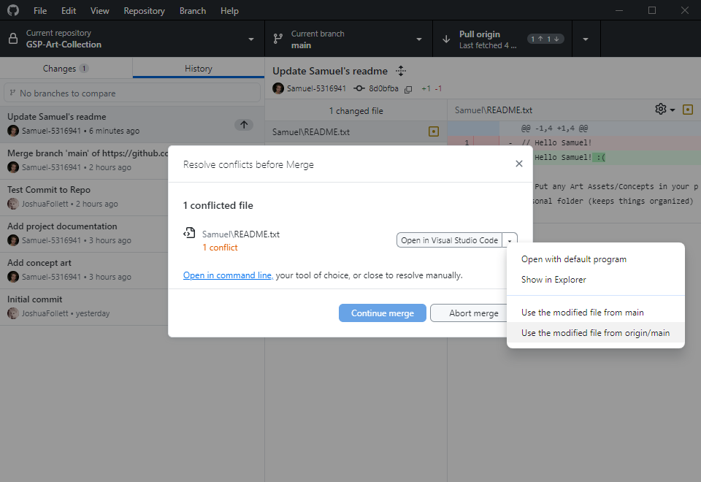
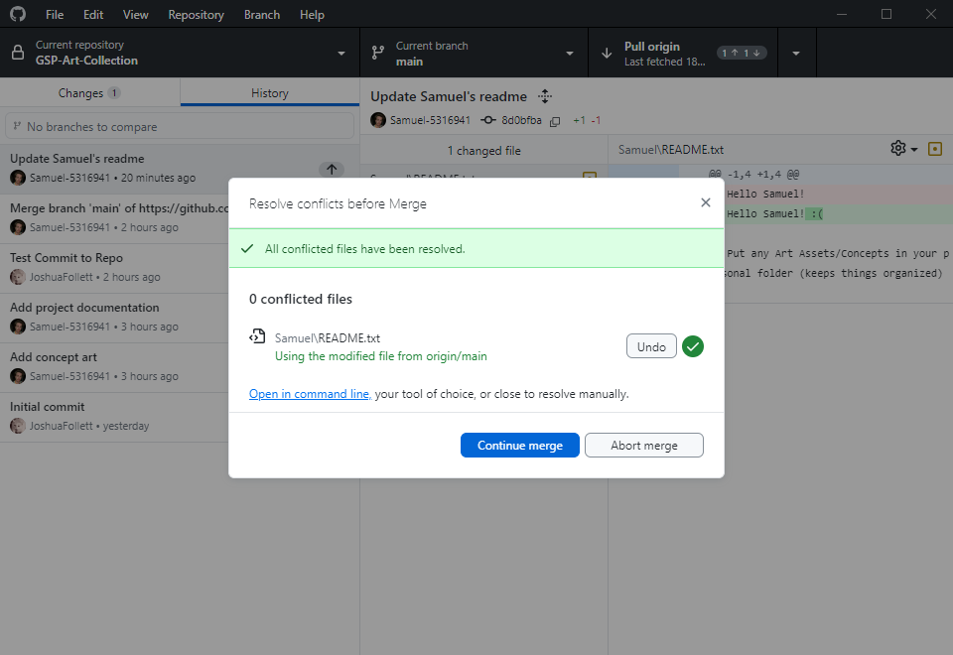
MERGE CONFLICTS (cont)
If you expand the dropdown, you can see two options:
Use modified file from main
Use modified file from origin/main
Here, main refers to the name of the branch you are on. Yours may not be called main (this is normally a protected branch).
The main consideration here is that the file from origin is the one you’ve pulled in, and the other is the file you edited that’s conflicting. You can choose one or the other. I will choose the one from origin to overwrite by file.
If I am so inclined, I might copy out my file to another directory to preserve it for now, before I choose Josh’s file, and add the changes back in later. This is completely acceptable, although Git methodology says that you should stash your changes and merge over them. You can also abort and try a rebase. I won’t cover those options but I mention them in the case you want to learn more elsewhere.

Slide 39
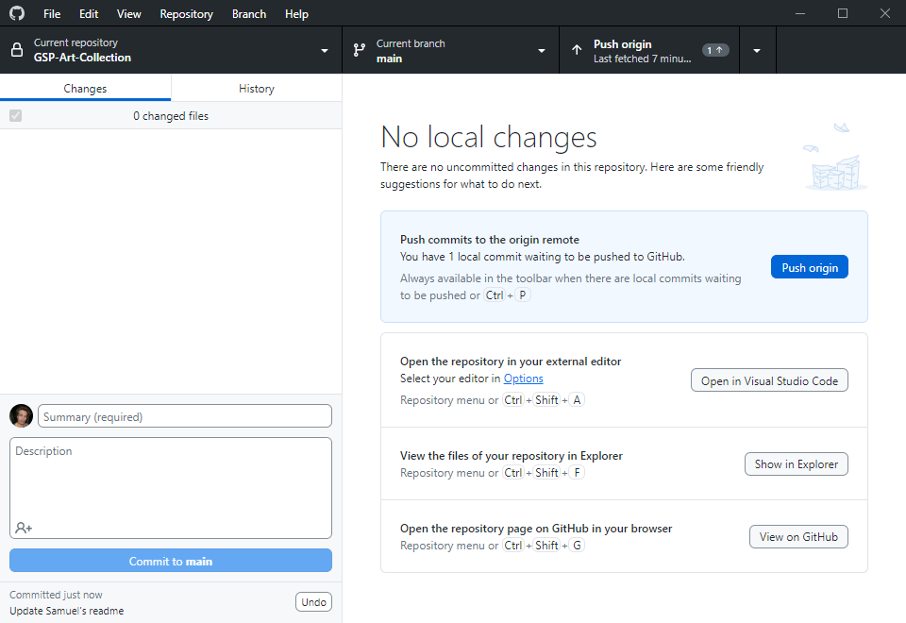
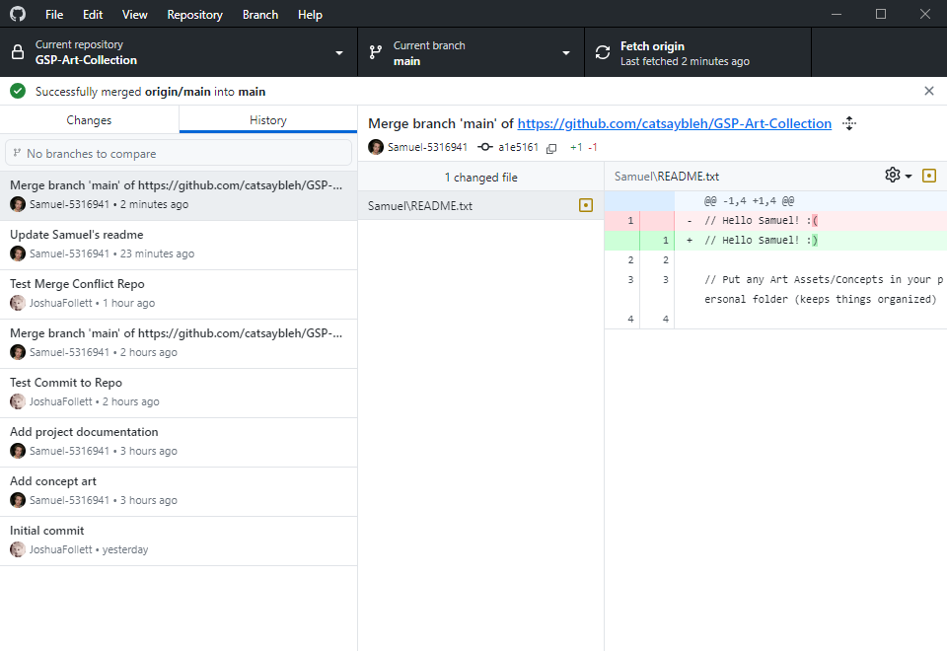
MERGE CONFLICTS (cont)
Now, you can see in the history that a merge commit has been created. The merge was successful but this still only locally available. I need to push my merge commit to fully resolve the conflict.
I must fetch again, and if there are no commits to pull, I will push my changes.
If you make a mistake, you can undo the latest unpushed commit right underneath the commit button. There are two types of “undo”: revert and reset. Git often will intelligently choose for you, but if it asks you for help deciding:
Revert is preservative: it changes the commit you made (and directory) to match the specified previous commit.
Reset is destructive in that it erases the commit, and depending on the type of reset, it can revert your files too.
If you made a mistake and want to undo the commit and the revert files, reset hard.
If you committed the wrong files but want to keep the edits you made, reset soft. This will undo the commit but leave the files alone and automatically stage them.
You should only try to undo pushed commits if you know the implications.

Slide 40
Branches

Slide 41
So far, all the examples we’ve talked about have involved two people. It is apparent how messy things can become between just two collaborators, let alone ten.
main
Alice and Bob have been working on their project: Alice is programming and Bob is texturing. There isn’t much overlap in their jobs so they have managed to get along so far without major headaches.
Now let’s add Carol, Dave, and Eve.
There are two main considerations. There will be an increase in the complexity of merge conflicts as the project grows, and bugs and problems will propagate to everyone else with no safeguards.
Eve is responsible for the main character. Alice, Bob, Carol and Dave all have an overlap with her role. They will have to edit files that Eve also needs to edit.
This might lead to a situation where Alice, Bob, Carol and Dave have all pushed commits without issues while Eve was working. Now, Eve pulls their changes, and suddenly there are many files which conflict with hers and hours of work for her to sort through.
Let’s make this example more contrived. Eve finishes her marathon conflict merge, but now her merges introduced a bug that breaks systems that all four of the others are involved with.
Do they bin Eve’s hours of fixing? Do they spend hours fixing themselves? Do they roll back to a point the bug didn’t exist and force everyone to lose work?
?
Alice
Bob
Carol
Dave
Eve

Slide 42
This team needs branches. In a nutshell, when a branch is made, it copies the current state of its parent branch. From here on out, changes made to the new branch will not affect the parent branch.
level
main
camera
Let’s take an example. Alice and Bob are tasked with making a camera system, and Carol and Dave are tasked with building a level. Alice and Bob implement a basic working camera for Carol and Dave to use for now, and Carol and Dave construct a simple blockout for Alice and Bob to run around in.
1
2
3
3
Alice and Bob branch from main. Now they are on a new branch called main/camera.
4
4
Carol and Dave branch from main. Now they are on a new branch called main/level.
This means that Alice and Bob can build the camera without fear of bugs affecting Carol and Dave. This also means that Alice and Bob can mess with Carol and Dave’s blockout, if they need to test some scenarios, without affecting Carol and Dave’s level.
Carol and Dave can build the level without disrupting Alice and Bob’s camera work. They can even tweak the camera if they need to see the environment better without affecting Alice and Bob.
Dave
Carol
Bob
Alice

Slide 43
Alice and Bob have finished their camera. How do Carol and Dave (and any other branches) get their camera?
level
main
camera
Branches can be merged or rebased in much the same way as your local branch is merged and rebased with the remote branch.
1
Alice and Bob merge their camera branch with the main branch. There aren’t any conflicts, as no one has touched the main branch since they split off.
2
3
3
3
Now, the main branch has the entire commit history of their branch (and the current state of their branch).
4
4
4
Carol and Dave aren’t finished with their level yet, but they can get Alice and Bob’s changes. They can rebase their branch onto main to get the finished camera feature from behind.
5
There is a conflict, though. Alice and Bob changed the blockout since Carol and Dave branched from main. So at each commit stage, they discard Alice and Bob’s level file. Since they know that there is no valuable work in Alice and Bob’s level file, they can resolve the conflicts without any effort.
6
6
7
It should be mentioned that when Alice and Bob merged, their branch didn’t disappear. If they want to implement new camera feature, they can carry on committing on the camera branch. Carol and Dave can rebase again after Alice and Bob merge.
Dave
Carol
Bob
Alice

Slide 44
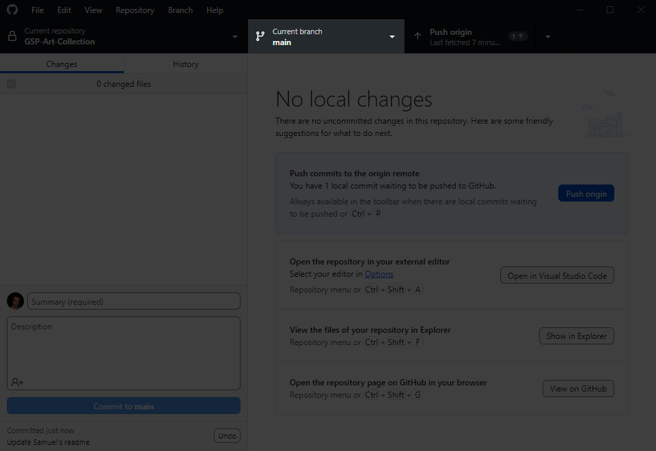
CHECKOUT BRANCH
Alice and Bob want to see their camera in action. The good news is, they’re not tied to main/camera. Instead of complicating things by rebasing, they can simply use their GitHub client to checkout the main/level branch. Their working directory will switch to Carol and Dave’s (and theirs will be preserved on the remote repository).
You can change the branch you are on very simply.
This is a powerful feature and your entire folder will change to the latest commit on the branch you switch to. You should only do this if you have no local changes. If you have unpushed commits, Git will preserve them in your local repository until you return to that branch, but switching branches will not push your local changes/commits for you.

Slide 45
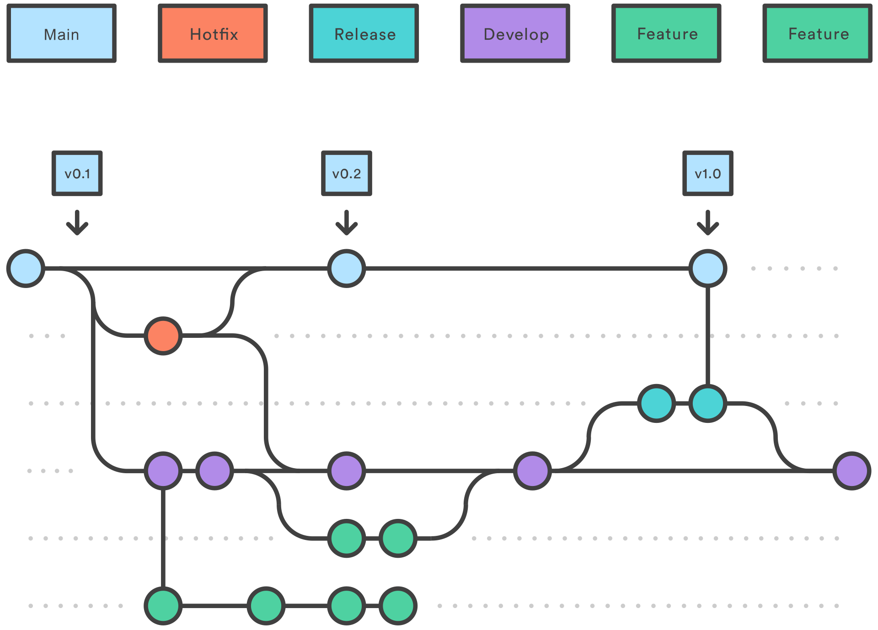
GITFLOW BRANCH STRATEGY
This is a diagram of the Gitflow branch strategy. It was once the predominant branch strategy, but it isn’t used as much anymore. This isn’t because it’s necessarily bad: it’s due to continuous integration of development and live service (think how apps like Instagram update almost every day).
However, Gitflow is still very suitable for projects that are scheduled and due to complete at a (somewhat) distant time in the future.
Follow the link if you want some additional information.
Please ignore their bias against this workflow. It is a good explanation of Gitflow, but they sell live-service software development tools, so they would actively not want their consumers to think this is a good solution for them. We aren’t going anywhere near live-service.
Gitflow Workflow | Atlassian Git Tutorial

Slide 46
This is a proposal of our branch strategy, and where everyone’s “home branch”, where you will push your work, might be.
As mentioned, you are not glued to one branch. It is easy to change between them to see what is going on elsewhere, to see your features in action on prod, and to help with QA testing, or to come to the rescue of someone in need of help with their asset.
Probably Drew will have to spend their time split between characters and assets! I have also not put boss anywhere; I thought probably he will want/need to switch between most branches.
Let’s discuss this to make sure everyone is happy with it.
main
Main branch should always compile a stable, tested game version: alpha -> beta -> gold
qa
No chores or features should be done on QA branch: everything’s pulled in when testing needs to start
prod
Production branch: assets/features are pulled together, level built/implemented, compile this branch for “live version”
Ren
Rui
feature
Feature branch for programming and implementing features concurrently (there’s often several child branches)
Josh F
Samuel
chars
Character branch that branches from feature; programming features are required to make characters function
Lottie
Roman
Drew
asset
Assets can be built and perfected in isolation from the the other development and each pulled when ready
Jovi
Sef

Slide 47

Cycle repeats for beta and for submission; except when qa begins for submission, development winds down
Reach alpha; production still continuing
Current development is pulled into qa, to begin testing a rough alpha: “wherever we’re at”
Project begins; blank Unity project is ready
Production is underway on all development branches
Finished features and assets are pulled into prod branch, level building continues (many times)
Alpha version is tested; production continues; work toward beta
Project initiation
QA for Alpha
QA for Beta
QA for Sub
Alpha
Beta
Sub
main
qa
prod
feature
chars
asset
This is not a timeline or a perfectly accurate blueprint. It’s a representation to help everyone understand how to work.

Slide 48
When you look at it from a top down perspective like this, it can be insightful to see how everything is pulled together with minimal conflict, but it can also be overwhelming or confusing. So, it is also beneficial to think about how this will work in practice from one person’s perspective, and what are the benefits.
[branch]
You and your branch collaborator(s) can work to add one feature at a time.
For feature/asset creators, your finished features can be pulled into production without you having to do anything, while you continue to work.
For people working on the production branch, you can have the finished features and assets pulled in without doing anything, while you continue to work.
For feature/asset creators, don’t have to stop working while QA and testing is ongoing. You can review bug reports or issues related to your work and implement them when time allows.
For production/qa, you can log bugs and issues and have them fixed by the time changes are next pulled in, without fixing them yourself.

Slide 49
ASSET FOLDER STRUCTURE
All of the heavy cache files are configured to be ignored by the repo. That means when you change and push, only your work is pushed, not your cache files.
Unity assets cannot have spaces in their filepath/filename.
Please do not commit changes to the repo from the wrong branch. If you are working on the assets branch, please do not edit the scenes, and if you are working on the production branch, please do not edit the models, etc.
Any changes you make in this way could be overwritten or undone! And probably unintentionally! If there is a bug or a glitch and it’s not your area, tell the responsible person, so that they can fix it. Please don’t try and edit it, you will create a merge conflict.
There is a WIP folder for anything you want to copy out and test a change that’s out of the scope of your branch. Our repository is configured to ignore any files in the WIP folder. Experiment away.
And finally, please do not store anything that is not a Unity asset. We have to be conservative with storage. Use the art repo or your WIP folder.
Rendering
Settings
Audio
Music
Ambient
Samples
Scripts
Library
Editor
Architecture
GameObjects
ScriptableObjects
Strings
Prefabs
UI
Components
Managers
Controllers
GameObjects
Scenery
Props
Characters
Effects
Animators
Models
Scenery
Meshes
Materials
Textures
Props
Meshes
Materials
Textures
Characters
Meshes
Materials
Textures
Scenes
WIP
We need to agree on this so everyone is happy.

Slide 50
Tracking

Slide 51

CHECKOUT BRANCH
Please watch this (relatively helpful) video to understand the tracking of bugs and issues on the GitHub website.
When you assign issues please do not assign them to individuals; someone might get landed with more than their fair share of work. Please assign them to teams like “programmers”, “prop artists” etc.
When you are working on fixing a logged issue, please use the methods in this video to link your commits that fix things with the issue they are fixing.

